Slide 1
Reciprocating Machine Tools

Slide 2
Shaper Machine
Planer Machine
Slotter Machine

Slide 3
SHAPER (SHAPING MACHINE)

Slide 4
SHAPER (SHAPING MACHINE)
It is a reciprocating type of machine tool
Used for producing small flat surfaces
With the help of a single point tool reciprocating over the stationary work piece
Surface may be horizontal, inclined or vertical

Slide 5
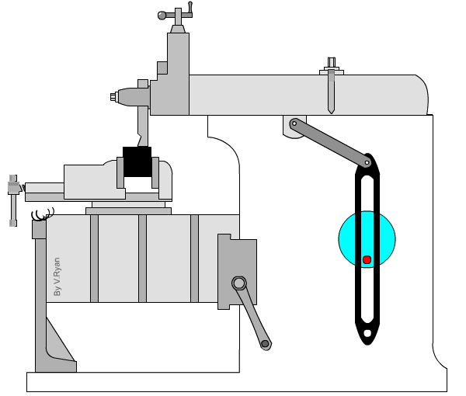

Slide 6
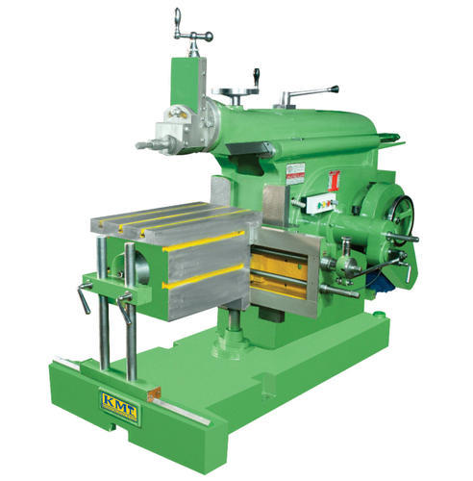

Slide 7
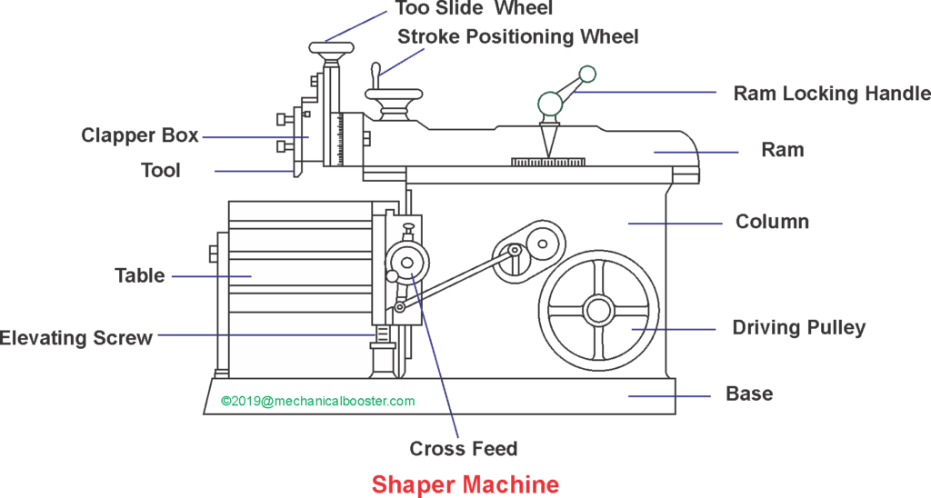

Slide 8
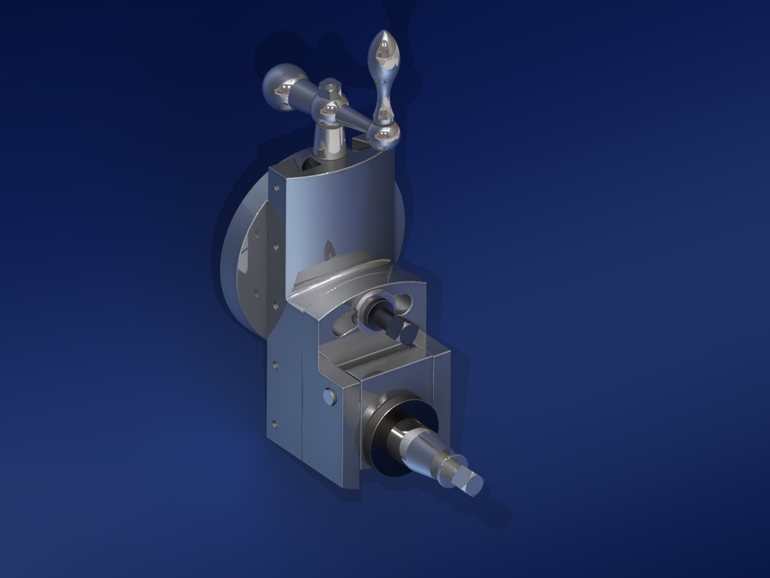

Slide 9
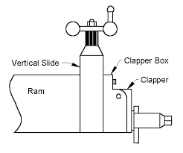
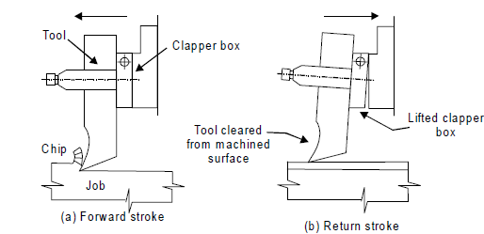

Slide 10
Base: It is a heavy structure of cast iron which supports other parts of a shaper.
Column: It is a box-like structure made up of cast iron and mounted upon the base. It contains the driving mechanism and is provided with two machined guide ways on the top of it on which the ram reciprocates.

Slide 11
Ram: It is a reciprocating member which reciprocates on the guide ways provided above the column. It carries a tool-slide on its head and a mechanism for adjusting the stroke length.
Tool head: It is attached to the front portion of the ram with the help of a nut and a bolt. It is used to hold the tool rigidly, it also provides the vertical and angular movements to the tool for cutting.

Slide 12
Cross-rail: It is attached to the front vertical portion of the column. It is used for the two purposes:
(a) It helps in elevating the table over the column in the upward direction, and
(b) The table can be moved in a direction perpendicular to the axis of the ram over this cross rail.

Slide 13
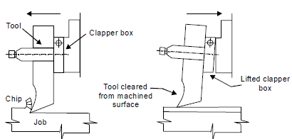
Table: It is used for holding the work piece. It can be adjusted horizontally and vertically with the help of spindles.
Cutting action and functioning of clapper box

Slide 14
SHAPER MECHANISM
In a shaper, rotary motion of the drive is converted into reciprocating motion of the ram by the mechanism housed within the column or the machine.
In a shaper metal is removed in the forward cutting stroke.
The return stroke goes idle and no metal is removed during this period.

Slide 15
The reciprocating movement of the ram and the quick return mechanism of the machine are generally obtained by anyone of the following methods:
(a) Crank and slotted link mechanism
(b) Whitworth quick return mechanism
(c) Hydraulic shaper mechanism

Slide 16
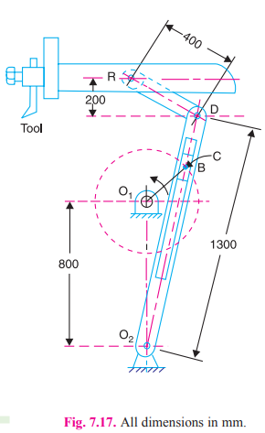
Crank and Slotted Link Mechanism

Slide 17
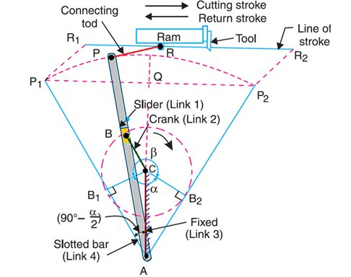

Slide 18
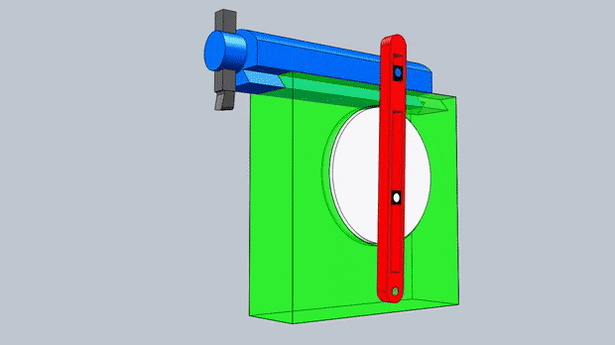

Slide 19
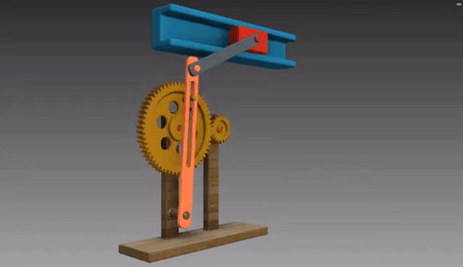

Slide 20
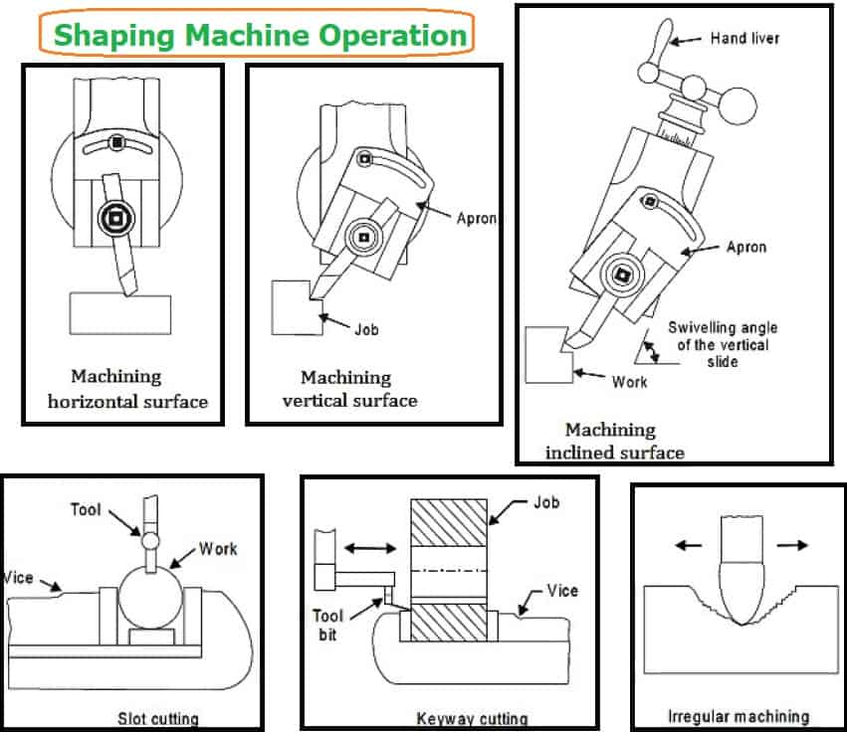

Slide 21
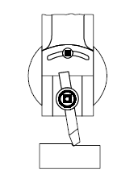
SHAPER OPERATIONS
Machining horizontal surface

Slide 22
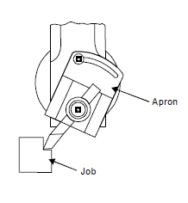
Machining vertical surface

Slide 23
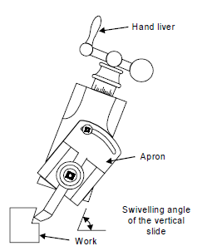
Machining angular surface

Slide 24
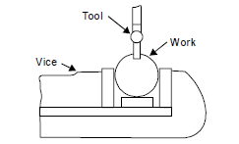
Slot cutting

Slide 25
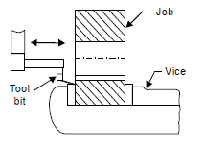
Keyway cutting

Slide 26
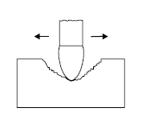
Machining irregular surface

Slide 27
PLANER (PLANER MACHINE)

Slide 28
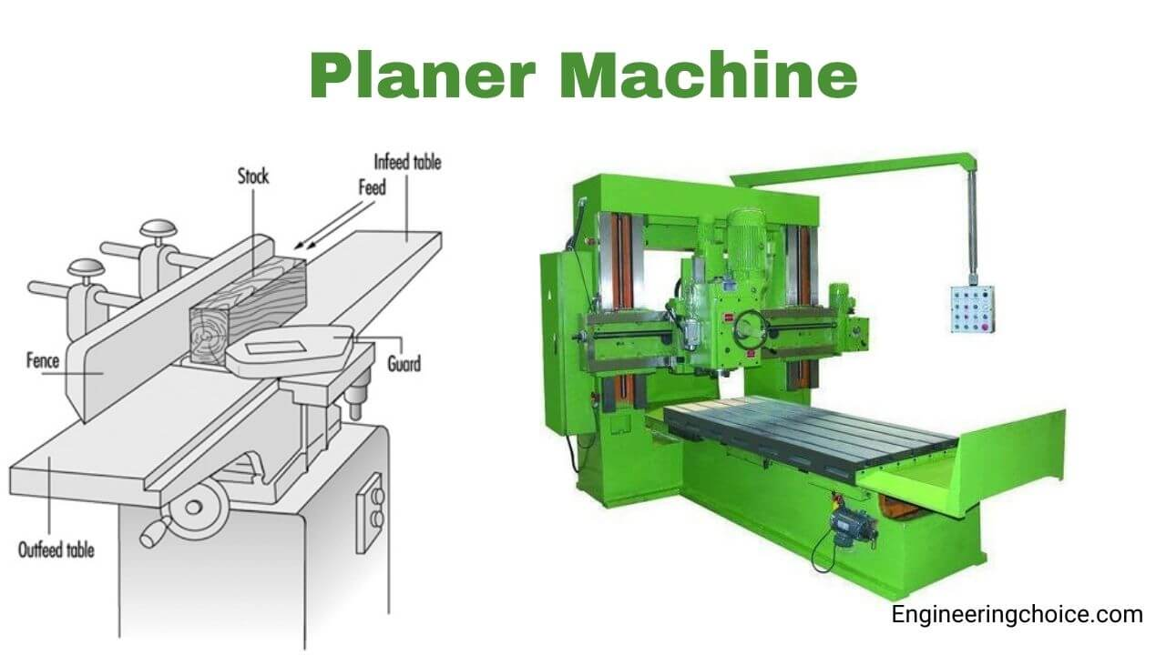

Slide 29
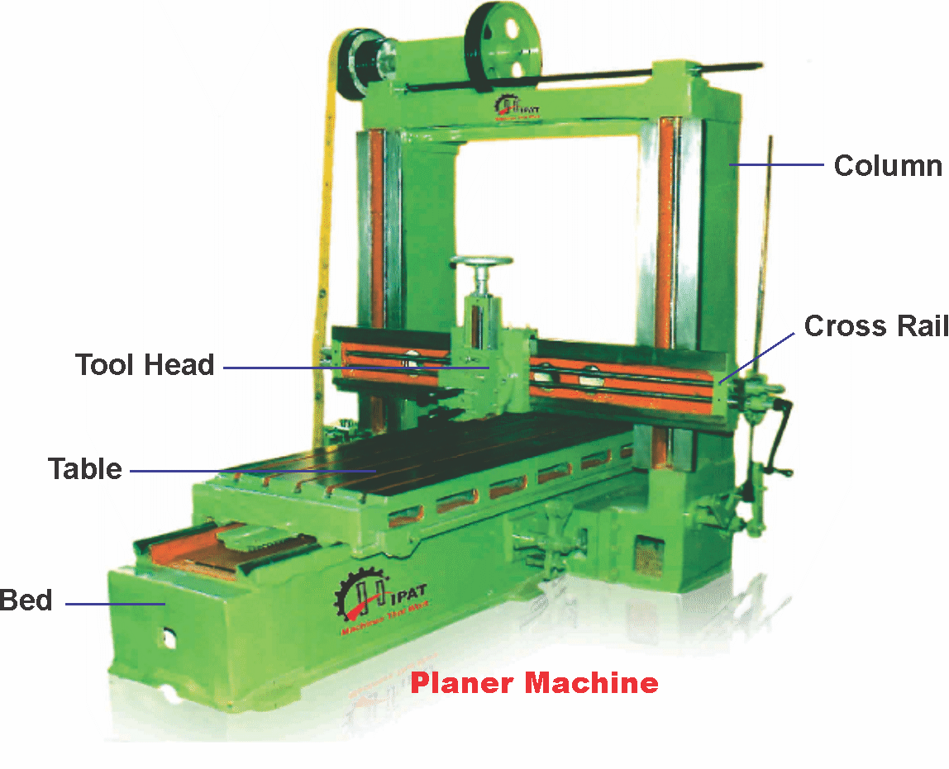

Slide 30
Like shaping machines, planing machines are also basically used for producing flat surfaces in different planes.
However, the major differences between planing machines from shaping machines are :
Though in principle both shaping and planing machines produce flat surface in the same way by the combined actions of the feed and depth of cut, but in planing machine, instead of the tool, the workpiece reciprocates giving the fast cutting motion and instead of the job, the tool(s) is given the slow feed motion(s).

Slide 31
Compared to shaping machines, planing machines are much larger and more rugged and generally used for large jobs with longer stroke length and heavy cuts.
In planing machine, the workpiece is mounted on the reciprocating table and the tool is mounted on the horizontal rail which, again, can move vertically up and down along the vertical rails.
Planing machines are more productive (than shaping machines) for longer and faster stroke, heavy cuts (high feed and depth of cut) possible and simultaneous use of a number of tools.

Slide 32
As in shaping machines, in planing machines also;
The length and position of stroke can be adjusted.
Only single point cutting tools are used.
The quick return persists.
Form tools are often used for machining grooves of curved section.
Both shaping and planing machines can also produce large curved surfaces by using suitable attachments.

Slide 33
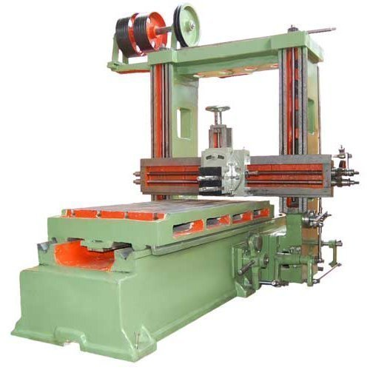

Slide 34
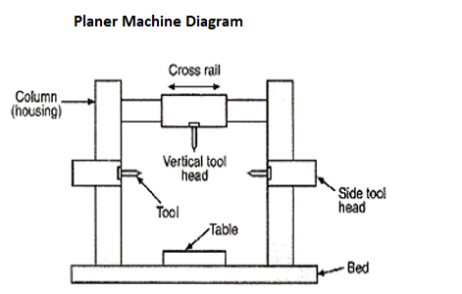

Slide 35
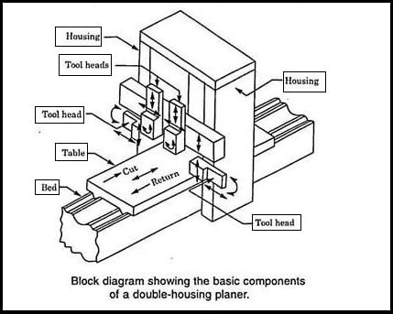

Slide 36
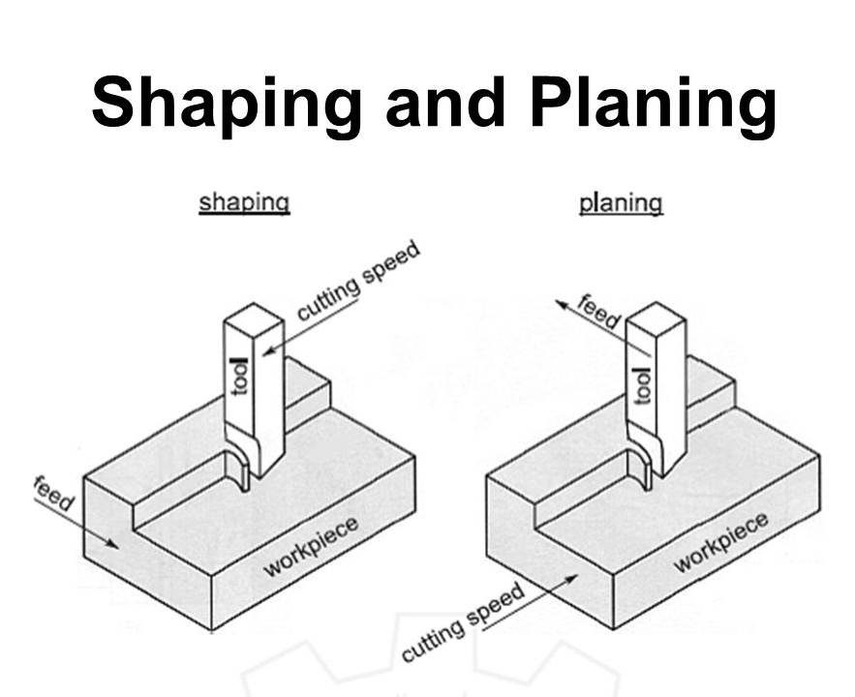

Slide 37
SLOTTER (SLOTTER MACHINE)

Slide 38
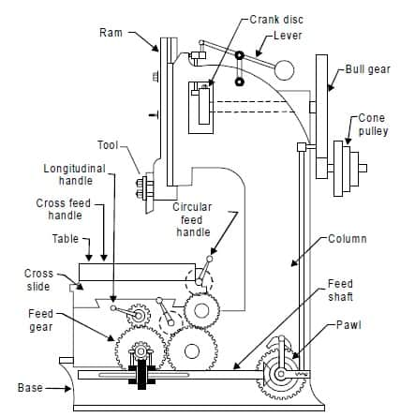

Slide 39
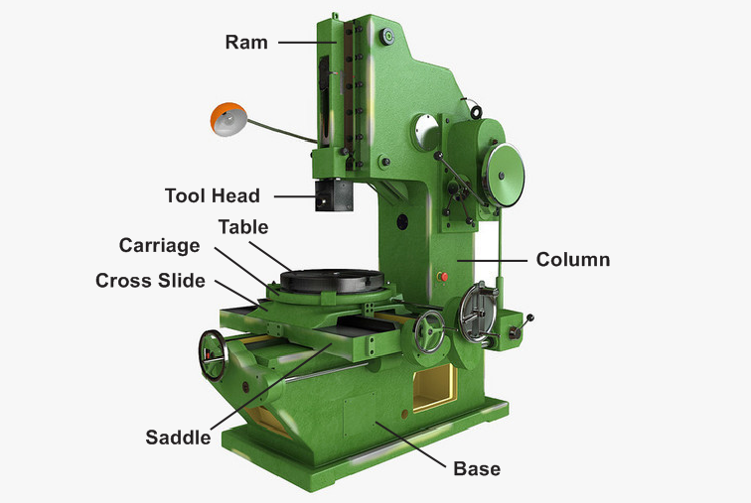

Slide 40
Slotting machines can simply be considered as vertical shaping machine where the single point (straight or formed) reciprocates vertically (but without quick return effect) and the workpiece, being mounted on the table, is given slow longitudinal and / or rotary feed.
In this machine, also the length and position of stroke can be adjusted. Only light cuts are taken due to lack of rigidity of the tool holding ram for cantilever mode of action.
Unlike shaping and planing machines, slotting machines are generally used to machine internal surfaces (flat, formed grooves and cylindrical).
Shaping machines and slotting machines, for their low productivity, are generally used, instead of general production, for piece production required for repair and maintenance.

Slide 41
Differences between Shaper, Planer & Slotter
 | Aspect | Shaper | Planer | Slotter
1 | Work-tool motion | Tool reciprocates in horizontal axis and work feeds | Work reciprocates horizontal axis and tool feeds intermittently | Tool reciprocates in vertical axis and work feeds intermittently
2 | Construction & rigidity | Lighter in construction & less rigid | Higher in construction & more rigid | Lighter in construction & less Rigid
3 | Motor power required | Relatively less power | Higher power comparted to shaper | Relatively less power

Slide 42
 | Aspect | Shaper | Planer | Slotter
4 | Typical work size & set-up time | Relatively small parts quick set-up time | Bigger parts require lengthy set up time | Relatively small parts, quick setup time
5 | No. of surfaces that can be machined | Only one surface at a time | Three surfaces can be machined at a time | Only one surface at a time
6 | Material Removal Rate (MRR) | Low MRR | High since multiple tools can be held at a time | Low MRR
7 | Tool size | Regular size similar to lathe | Bigger size | Regular size similar to lathe
8 | Range of speeds & feeds | Smaller range & smaller number of speeds and feeds | Wide range and more number speeds and feeds available | Smaller range & smaller number of speeds & feeds

